Slide 1
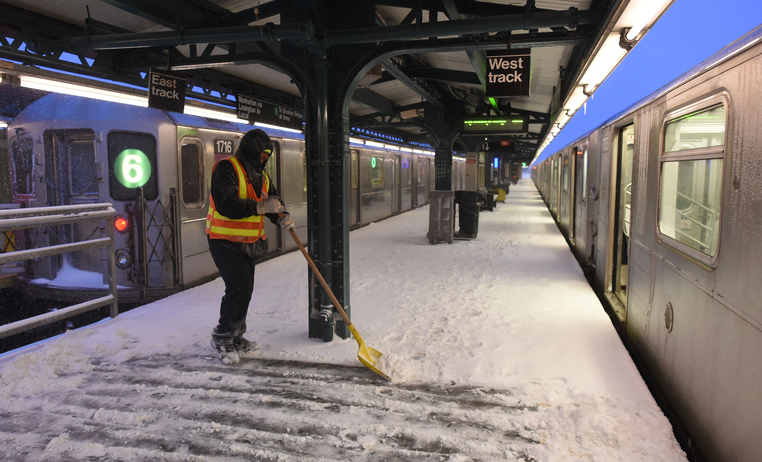
Exploratory Data Analysis: Advice for NYC Metro Scheduling
Josh Jingtian Wang
Metis
Jan 25, 2022
pic source: pix11.com

Slide 2
Backstory
Client
Metropolitan Transportation Authority (MTA)
Question
What factors potentially affect NYC metro ridership?
Purpose
Modify train scheduling to reduce budget
Deliverables
COVID vs Metro
Uber/Lyft vs Metro
Weather vs Metro
Metro ridership trend in a year/week

Slide 3
Data
Metro data
http://web.mta.info/developers/turnstile.html
COVID data
https://github.com/nytimes/covid-19-data
Uber/Lyft data
https://data.cityofnewyork.us/Transportation/FHV-Base-Aggregate-Report/2v9c-2k7f
Weather data
https://www.ncdc.noaa.gov/cdo-web/

Slide 4
Methods
Data acquisition
SQL
Python (SQLAlchemy)
Data Cleaning and Manipulation
Python (pandas)
Visualization
Python (matplotlib, seaborn, calplot (calendar heatmaps))

Slide 5
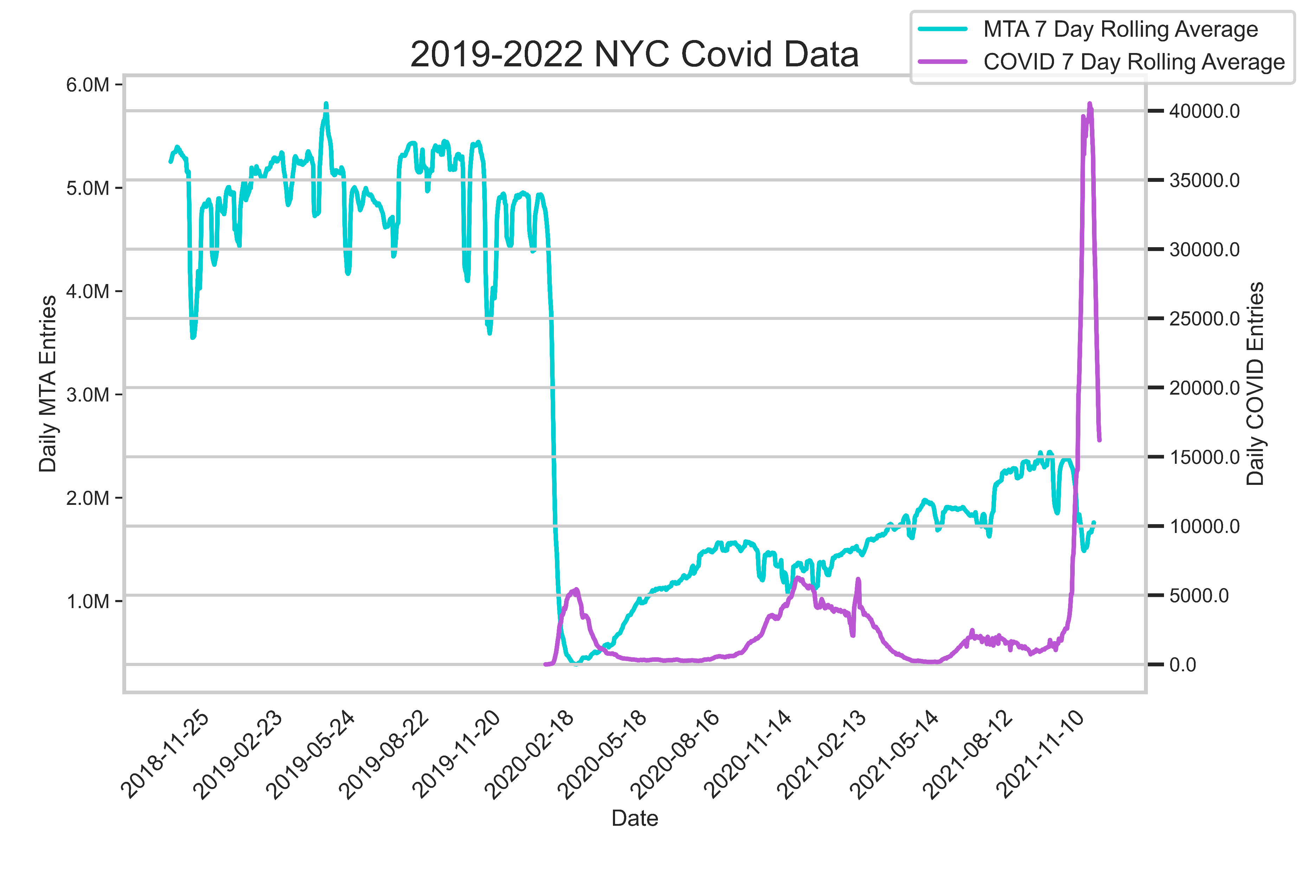
COVID Cases vs Metro Ridership
Takeaway: Rises in metro ridership (re-opening) are often followed by COVID waves.

Slide 6
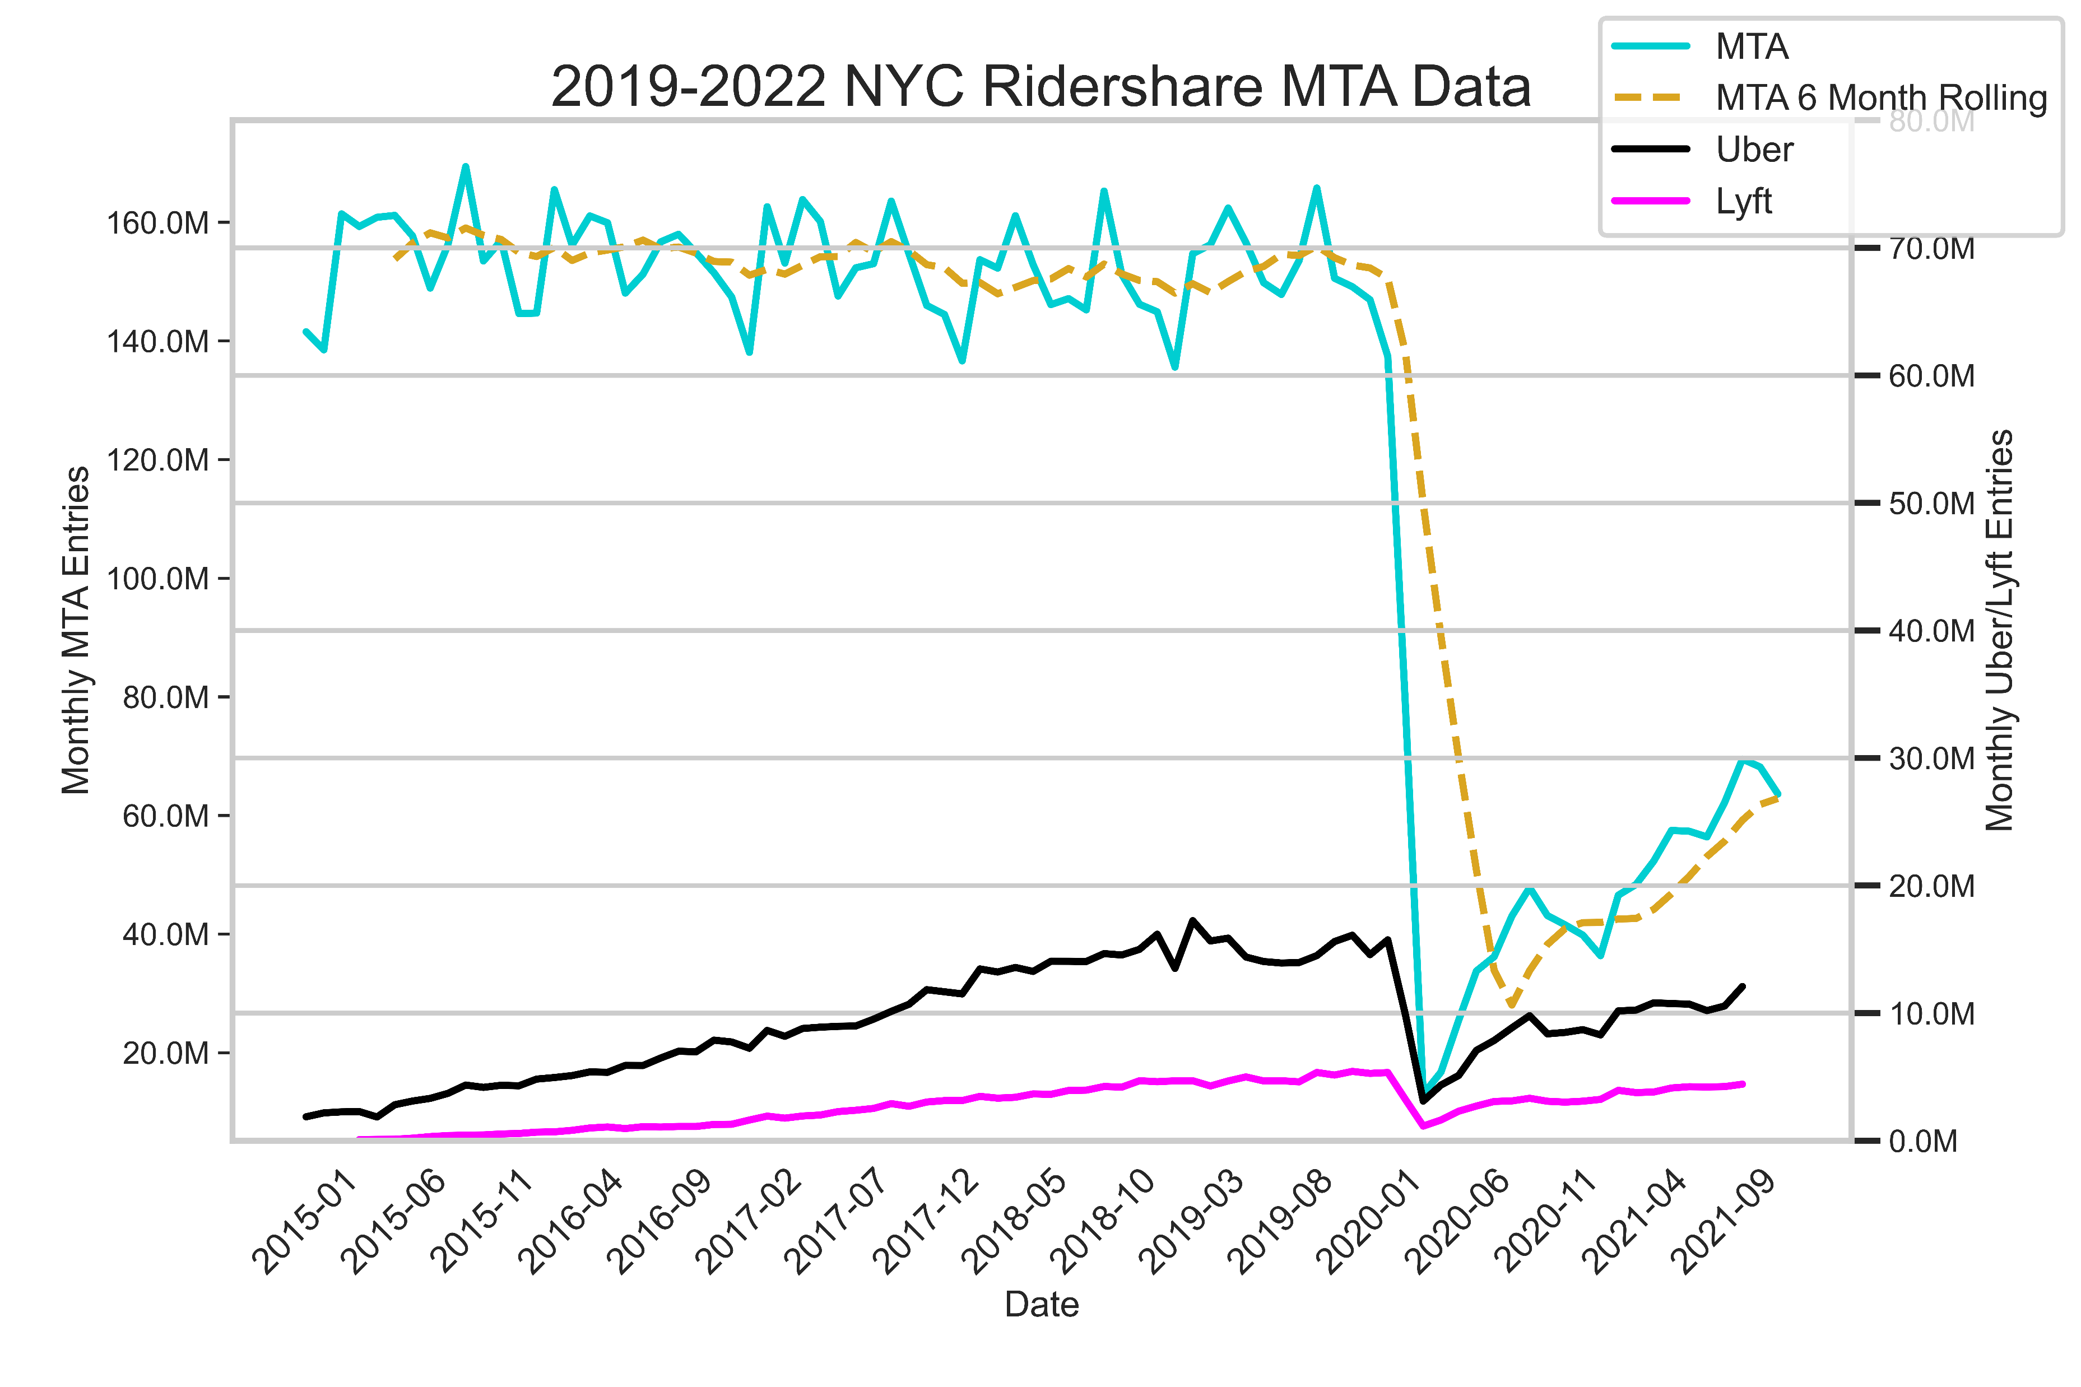
Rideshare Services vs Metro Ridership
Takeaway: The rise of Uber/Lyft may have contributed to the slight decline of pre-COVID NYC metro ridership.

Slide 7
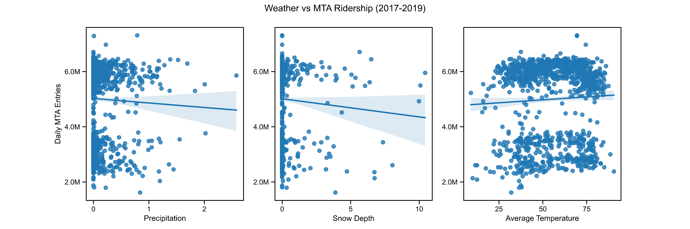
Weather vs Metro Ridership
Takeaway: NYC metro ridership is negatively correlated with rainfall and snowfall, and positively correlated with ambient temperature. The relationships are not strong.

Slide 8
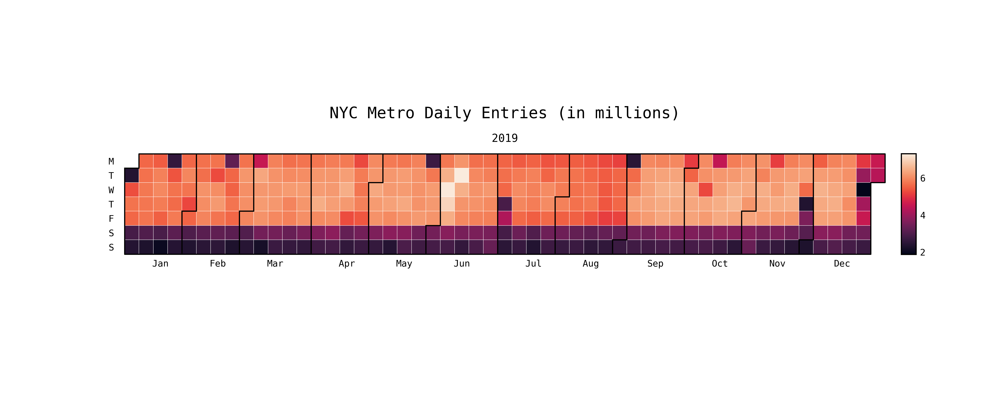
Daily Metro Ridership Trend (2019)
Takeaway:
Low ridership on holidays, weekends.
Higher ridership in Spring and Fall than in Winter and Summer.

Slide 9
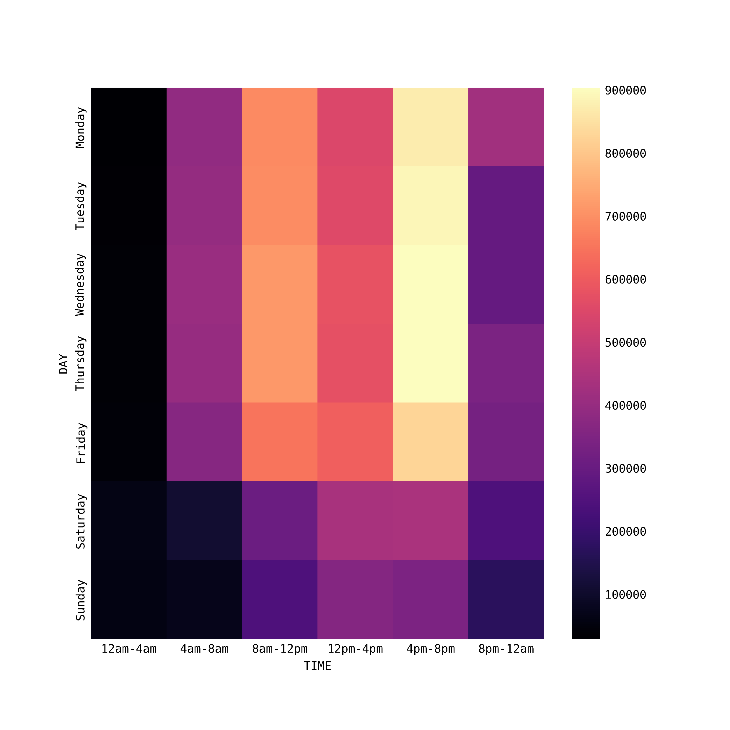
Hourly Metro Ridership Trend (2019)
Takeaway:
Low ridership on weekends.
High ridership from 8am to 8pm on weekdays.
Notes:
Removed holidays
Data skewed for March to November

Slide 10
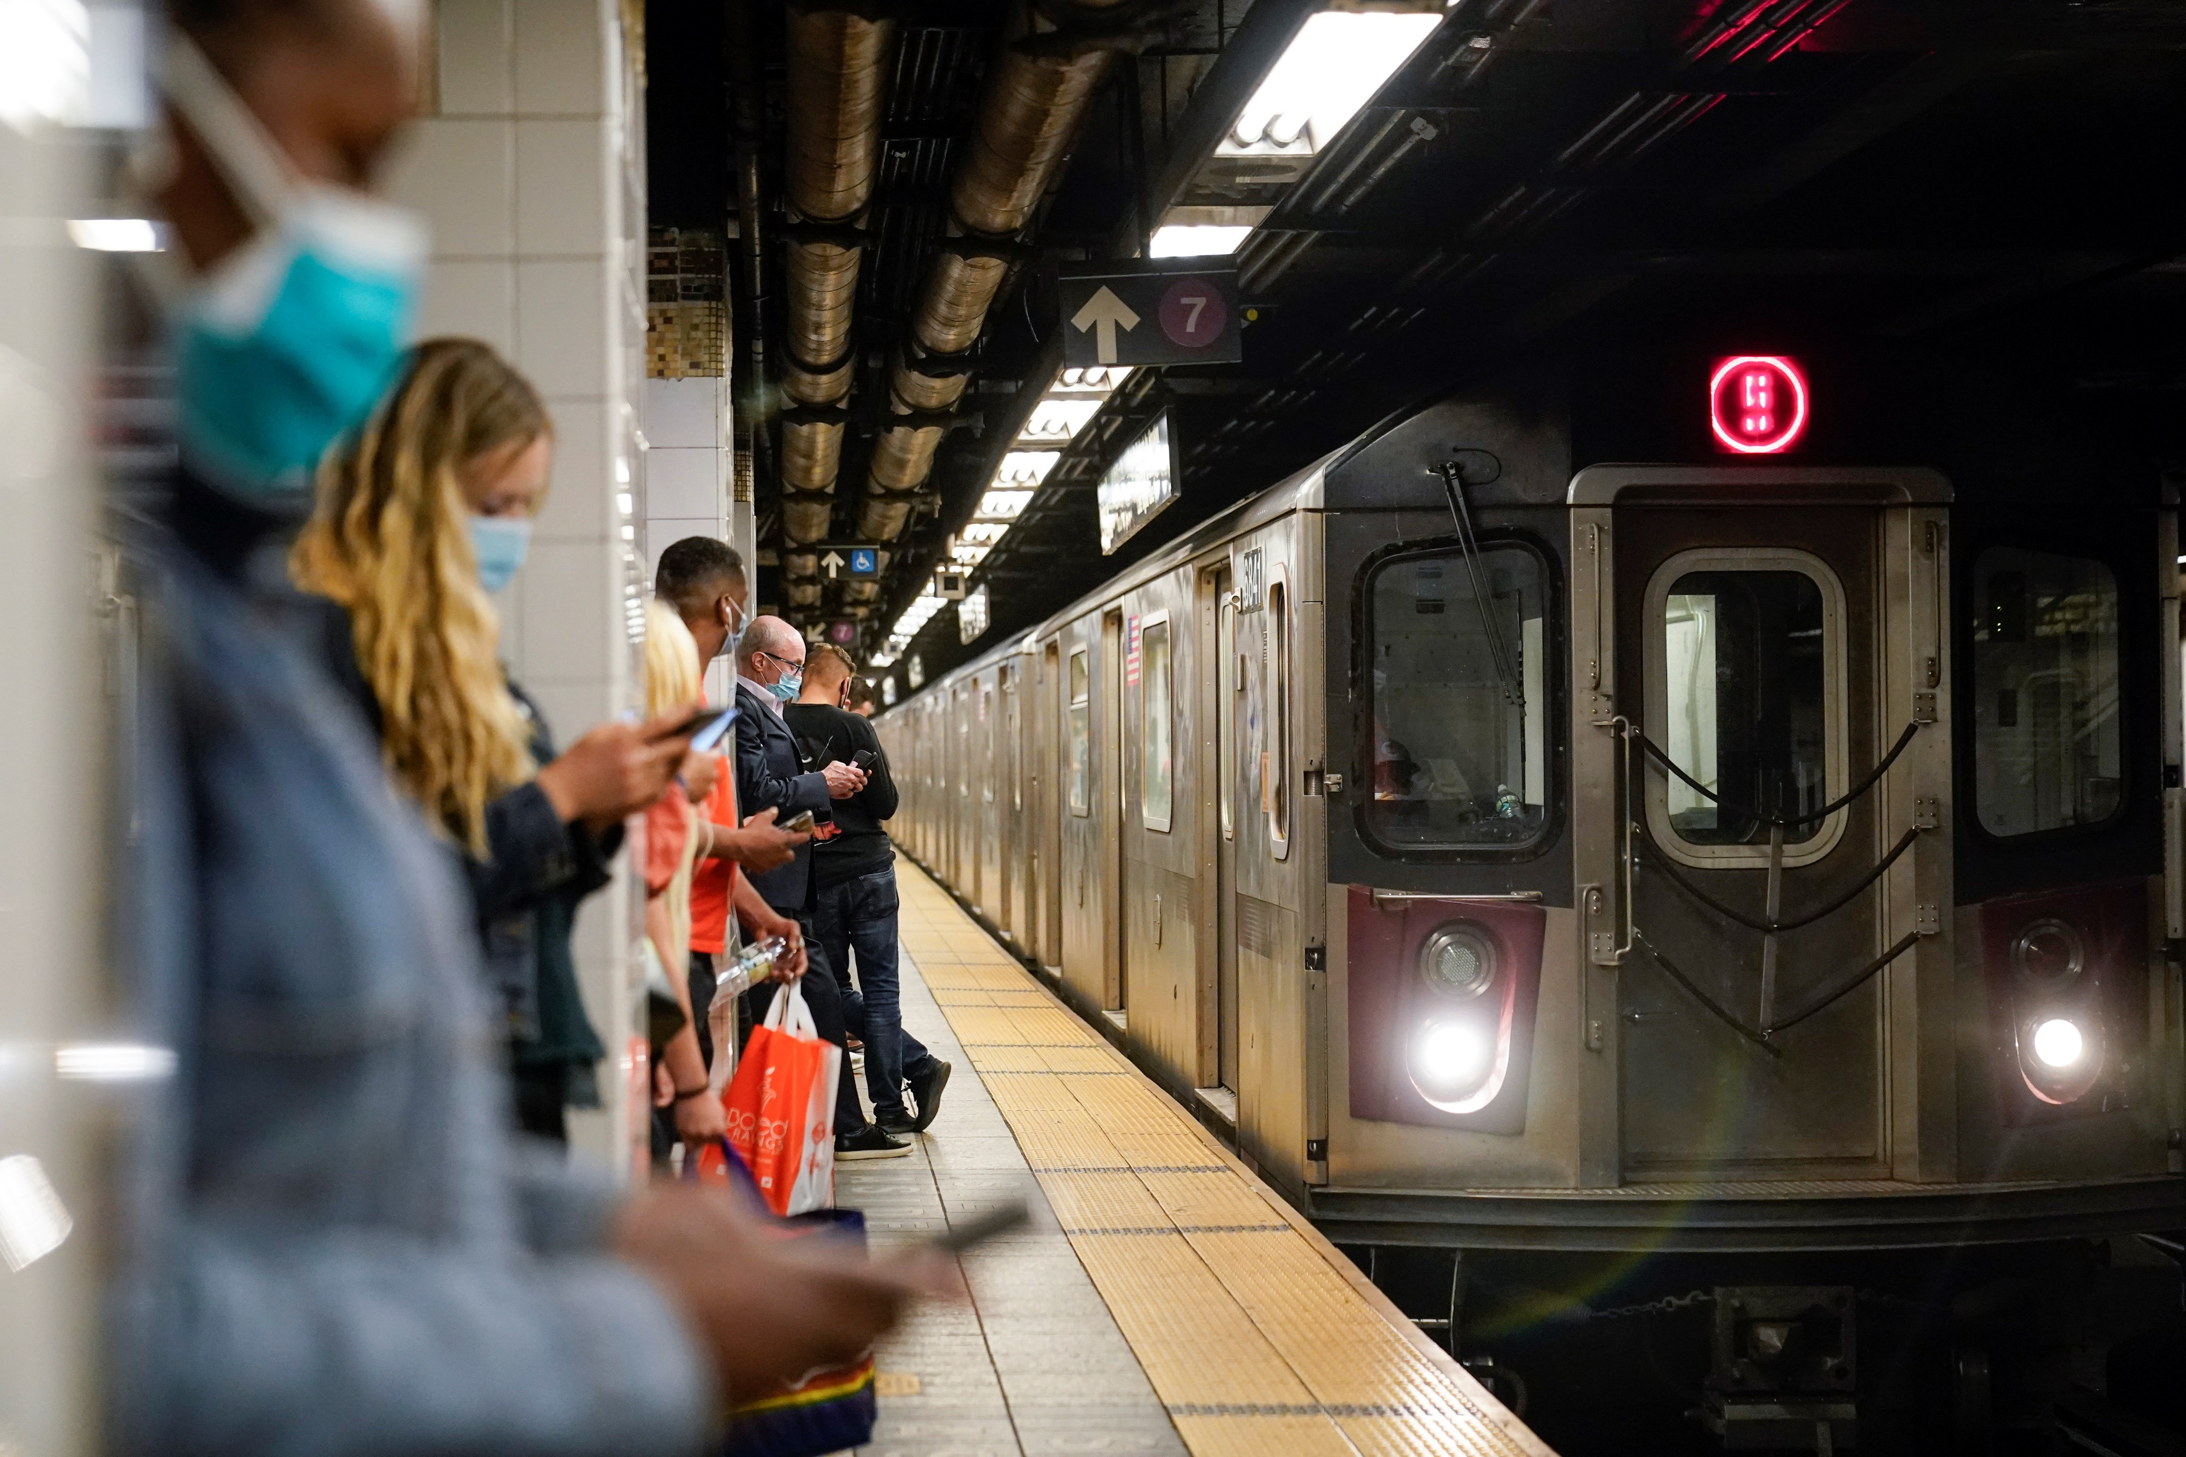
Advice
COVID waves and rideshare services potentially affect NYC metro ridership
Weather may not be a strong enough factor to warrant train scheduling change
Fewer trains can be scheduled on holidays, weekends and at nighttime.
pic source: nydailynews.com

